Slide 1
From Vertices to Edges
Focus so far has been on Vertices (Nodes)
  Actors/Agents
  Classical "variable" sociology
    Model how trait of a person --> Behavior
  Structural (Network) Property: Centrality, CC, Degree (Network Size), Network Composition
  Ego Networks
What about the edges (dyads)?
Critical for dynamic analysis
  tie formation and persistence (or decay)
  flows and weighted edges based on interaction events
    Strength, reciprocity
  generative processes - network evolution model (rules)

Slide 2
Dyads
Binary arc data (presence/absence)
Dyadic Census - 3 states
  Null Dyad
  Asymmetric Dyad
  Mutual Dyad
Tie formation (link prediction) & persistence
  Longitudinal Data
  Formation or Persistence
Notes:
1997 Social Networks Special Issue
Wellman: Community Lost, Saved, Liberated; strong ties; life-course effects; not densisty or degree
Morgan: Core and Periphery ties
Bidert Life course 3 types of trajectories
Martin: Ego and dyad effect, e.g. homopholy, embeddedness.

Slide 3
Social Ties and Interaction Events
What is a social tie?
Dyadic social interactions
  playing tennis, having sex, talking with, collaborating together on, exchanging with, giving to, receiving from
Events: instances of interaction
  event traits: initiating, waiting times, sequencing
Communicative interactions
  Initiating, who provides information, time talking, length of messages
Exchanges
  Who gives what to who; who receives what from whom
Aggregating events by time period
  Tie: at least one event (interaction, exchange) in a given time period
Notes:
need measures of both direction of event and intensity of flow

Slide 4
Dyadic Relationships - 3 Types
Symmetric (mutual): If A R B then B R A
  E.g., Spends time with, plays tennis with
Antisymmetric: Can not be reciprocated
  e.g. employer-employee
Asymmetric: Can be reciprocated
  Liking, advising, texting
Martin, John Levi. Social structures. Princeton University Press, 2009.

Slide 5
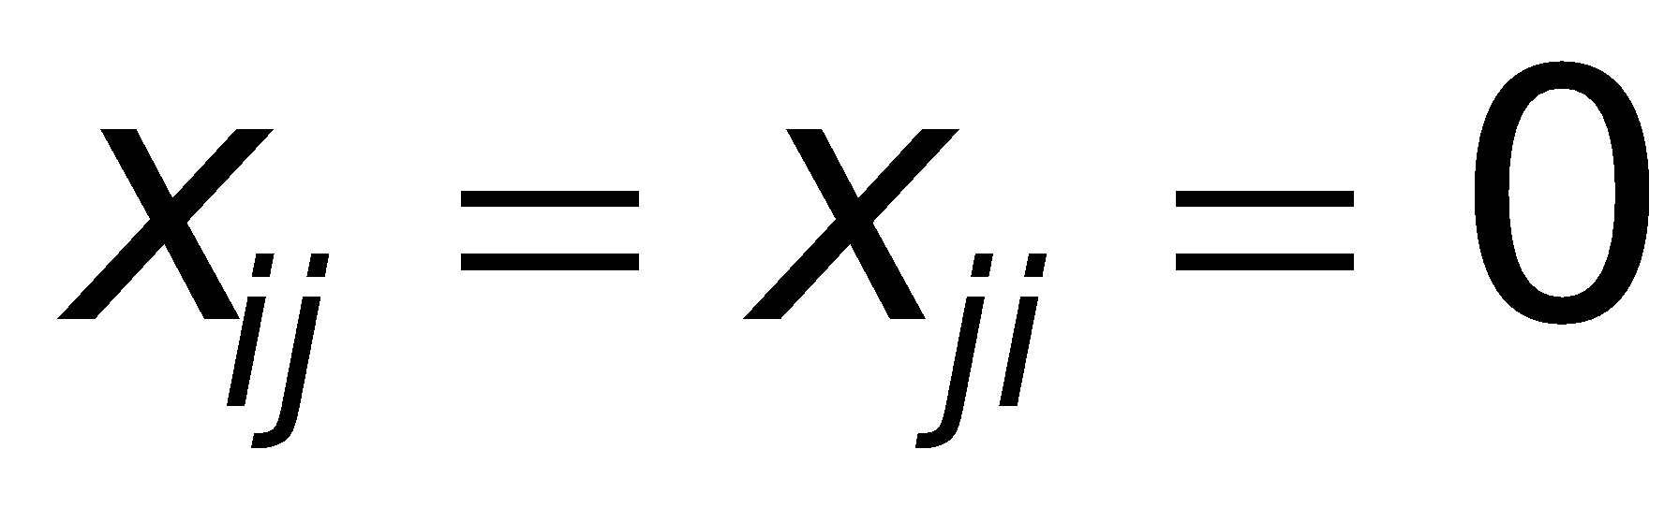
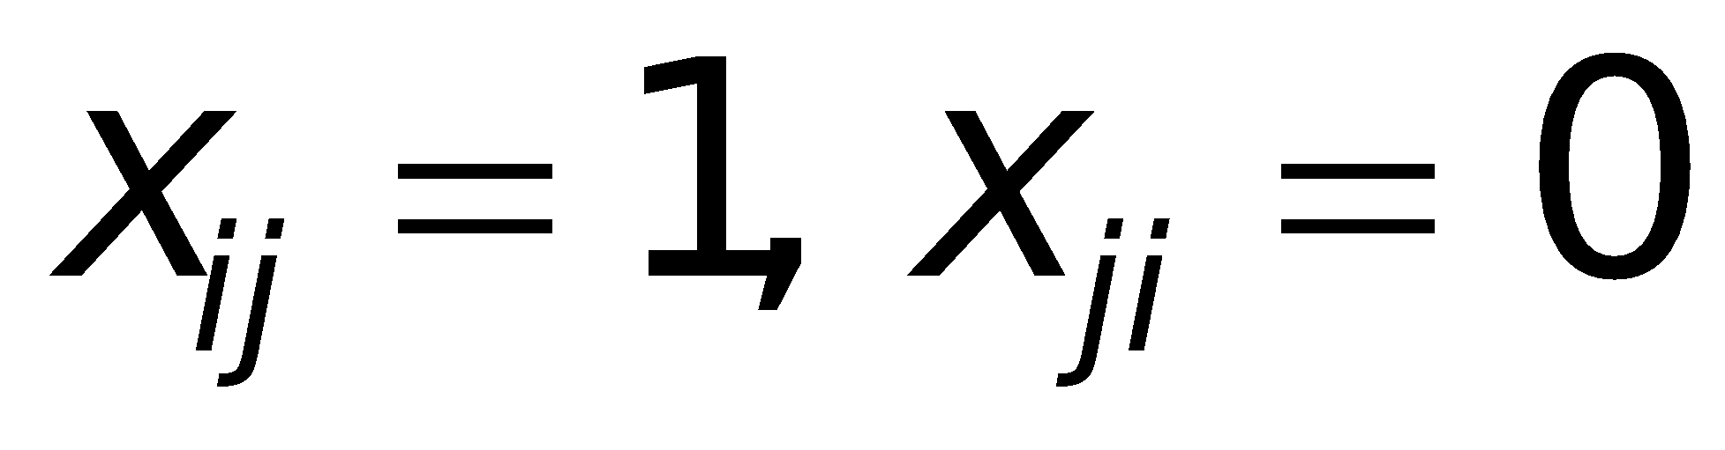
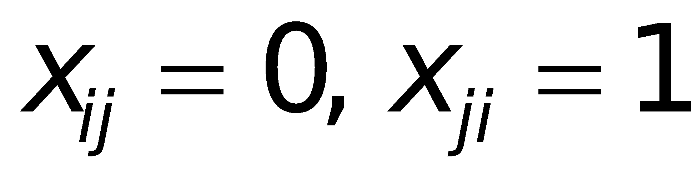
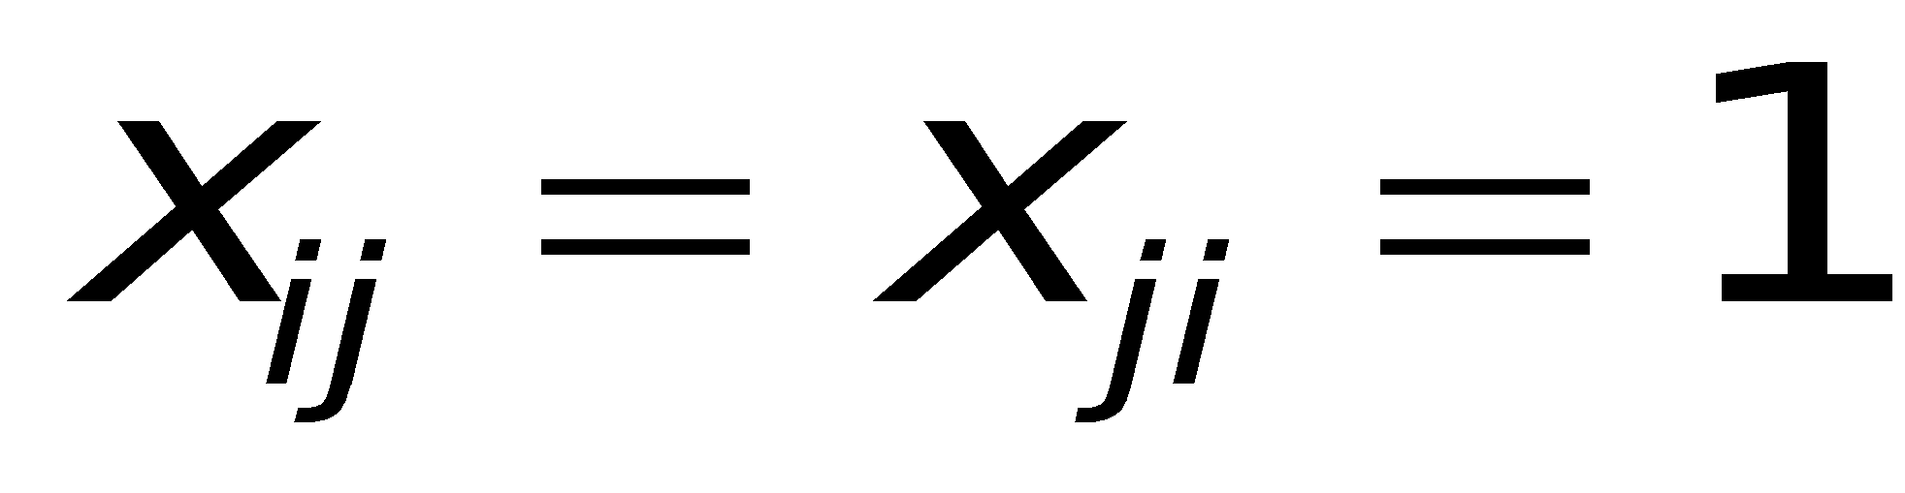
Dyadic Census
Null Dyad
Asymmetric Dyad
Asymmetric Dyad
Mutual Dyad
‹#›
Notes:
‹#›

Slide 6
Norm of Reciprocity
Golden rule: Do unto others as you would have them do unto you
Reciprocity = mutual dyad
Is this a norm?

Slide 7
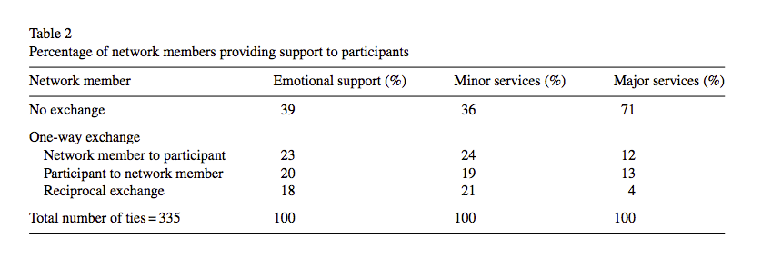
Social Support in Networks (Wellman)
Who is more likely to give support?
Who is more likely to receive support?
Are people more likely to give support if they have received support?
Types of support
  Emotional
  Minor Services
  Major Services
  Financial
Data: 1977-78 E. York Study: 29 people, 3335 ties, 335 active ties

Slide 8
Causes of Giving Support
Kin
Friendship
Neighbors (proximity, contact)
Demographic traits (gender, marital status, age, SES)
Similarity
Tie Strength
Network Size
Reciprocity (Receiving support → Give support)

Slide 9
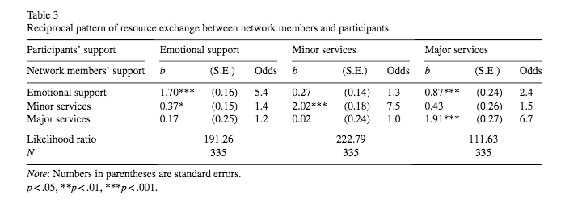
Reciprocity: Restricted & Generalized
People are more likely to give a type of support to someone if they have received support of that type from that person.
People more likely to give emotional support to someone if they have received major services from them (but not the reverse)

Slide 10
Cumulative Logistic Regression
Ordinal dependent variable
Estimated coefficients are effects of X on log odds of contrast between a lower category and the next higher category
Three categories
  No exchange
  One-way resource provision by network member to participant, but not in the other direction (giving but not receiving)
  Two-way (reciprocal) exchange of that resource (emotional support, etc.) between network member and participant (giving and receiving)

Slide 11
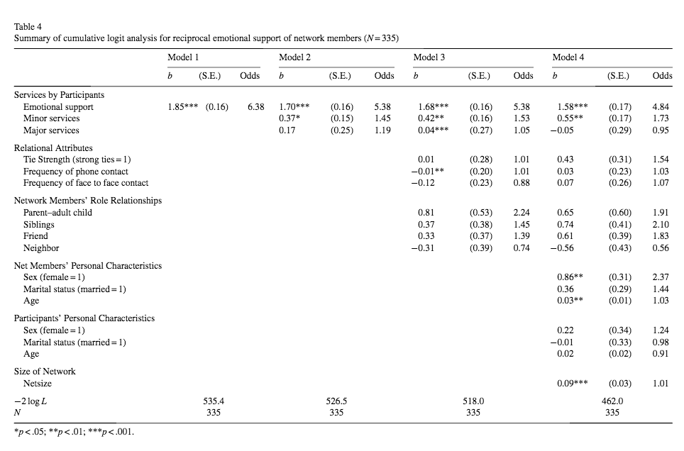
Emotional Support

Slide 12
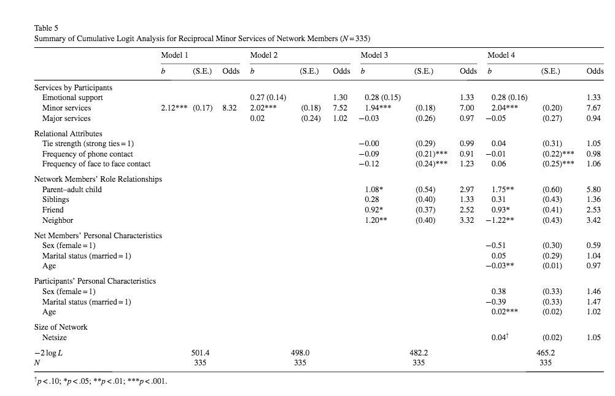
Minor Services
Notes:
Age
Participant effect Older people more like to give than no exchange, and to give after receiving than not give after receiving
-- Net member effect: if the tie is with an older person, less likely for ego to give than nothing, and less likely to give after receiving the minor service. Reversed: if tie is with a youger person more likely for ego to give to younger person, and more likely for ego to give after receiving

Slide 13
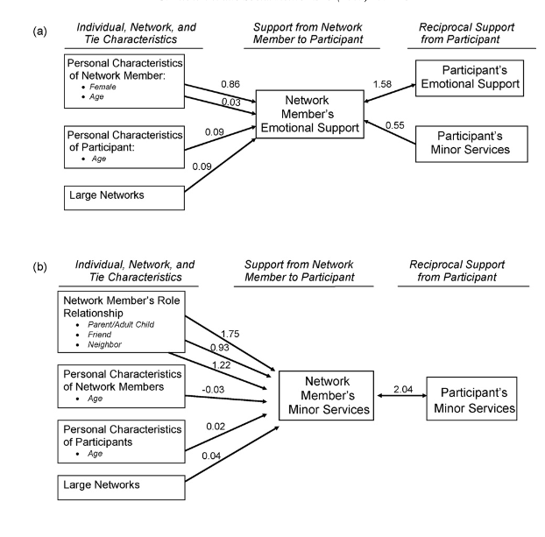
Overall Model
Two-step Model
Predictors of Receiving Support
Predictors of Reciprocating

Slide 14
Limitations of Binary Data
With only binary data, oversimplified contrast between non-symmetric and mutual dyads
Mutual dyads can be non-reciprocal
Among mutual dyads there can be variability in the level of reciprocity
Need to bring in intensity of tie (weighted edges)

Slide 15
Social Ties and Interaction Events
Tie: Link through which events occur
  Through ties events (interactions & exchanges of resources) "flow"
Directed flow: initiated event, sender (giver) and receiver
Strong ties: Large flows (number of events), bandwidth
Reciprocal ties: Balanced flows
  Balanced counts aggregated from information on the occurrence and traits of interactional events within a time window
  A temporal event sequence A->B->A->B

Slide 16
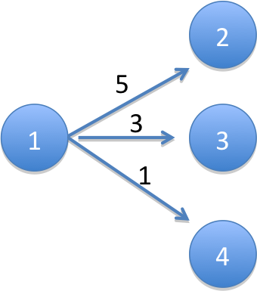
Directed Weighted Edge Graphs
Arc (x_{ij} = 1): if there was an interaction between i and j within a given time period and i initiated that interaction (e.g., a call from i to j)
Outflow Parameter (m_{ij}): Count of the number of interactions between i and j that were initiated by i in a given time period (e.g., number of calls made by i to j)
x₁₂ = x₁₃ = x₁₄ = 1
m₁₂ = 5
m₁₃ = 3
m₁₄ = 1

Slide 17


Node Level Properties
Out-degree (d_{i}): count of number of j nodes that i has initiated interaction with in a given time period (e.g., number of people i called)
Vertex Strength (m_{i+}): activity level of a node, i.e. count of the number of interactions initiated by i with all i’s j neighbors in a given time period (e.g., total number of calls made by i)
d₁ = 3
m₁₊ = 5+3+1 = 9

Slide 18


Arc Flows & Vertex Strength
conditional transition probability: probability, given that an event has been initiated by i, that it is with j.
p₁₂ = 5/9 = .556
p₁₃ = 3/9 = .333
p₁₄ = 1/9 = .111
m₁₂ = (m₁₊) (p₁₂)
5 = 9 x (5/9)

Slide 19

Tie (Arc) Strength
Arc Flow: m_{ij} = (m_{i+}) (p_{ij})
Transition Probability: p_{ij}
Relative Strength: m_{ij}/max(m_{ik})
Vertex Strength: m_{i+}
Dyadic Edge Strength
(bandwidth)

Slide 20
Reciprocity: Simple Model
R_{ij}(1) = |m_{ij} - m_{ji}|
R_{ij}(2) = ln(m_{ij}) - ln(m_{ji}) = ln(m_{ij}/m_{ji})

Slide 21
Reciprocity: Behavioral Model
Why would j initiate interaction with i more (or less) than i initiates interaction?
Local knowledge:
  i knows: m_{ij}, m_{ji}, d_{i}, m_{i+}
  i does not know: d_{j}, m_{j+}
  assumes m_{j+} = m_{i+}, d_{j}= d_{i}
Weight m_{ij} by m_{j+}/m_{i+}
Rij(3) = |m_{ij}(m_{j+}/m_{i+}) - m_{ji}|
Rij(4) = |ln[m_{ij}(m_{j+}/m_{i+})] - ln[m_{ji}]|
= |ln[(m_{ij}/m_{i+})/(m_{ji}/m_{j+})]|
= |ln (p_{ij}/p_{ji})|= |ln(p_{ij}) - ln(p_{ji})|
Notes:
logged means Rij = 0 when pij = pji
note if mi+ = mj+ reduces to

Slide 22
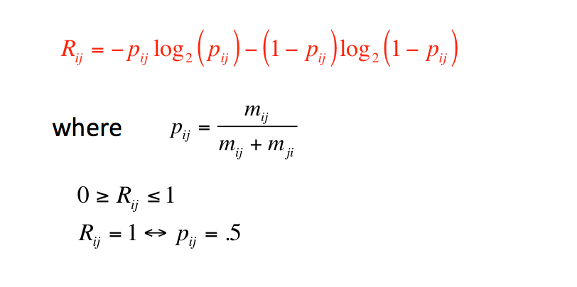
Reciprocity: Information Gain

Slide 23


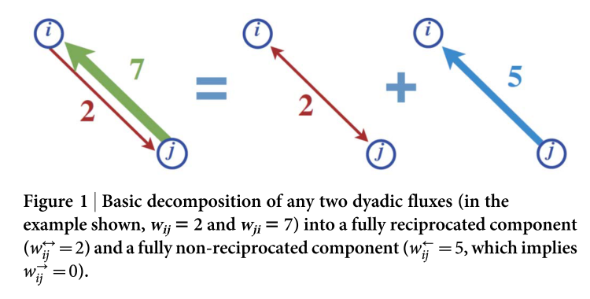
Directional Reciprocity

Slide 24
Why non-reciprocity
Given norm of reciprocity
Two explanations for non-reciprocity:
  Degree disassortativity
    A has more friends than B
  Unequal dispersion of activity among friends
    A’s ties to her friends vary in their strength

Slide 25
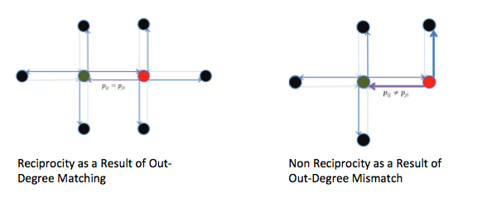
Explaining (Non-)Reciprocity
Out-Degree Mismatch

Slide 26
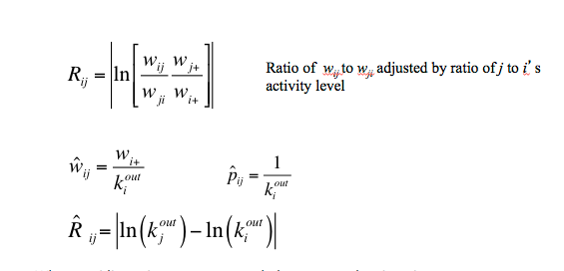
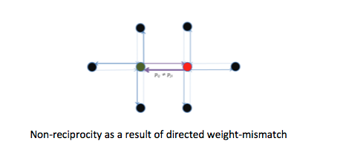
Explaining (Non-)Reciprocity
Unequal dispersion: p_{ij} ≠ p_{ik}
when equidispersion, vertex strength drops out and reciprocity a function of degree differences
degree differences --> non-reciprocity
unequal dispersion --> non-reciprocity
same degree
red vertice overdisperses

Slide 27
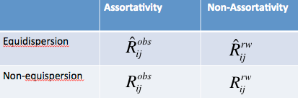
Four Variants of Reciprocity
Observed Network: Assortative & non-equidispersed
Equi-dispersed Model: Assortative & equidispersed
Rewired: Non-assortative and non-equidispersed
Rewired with Equi-dispersion

Slide 28
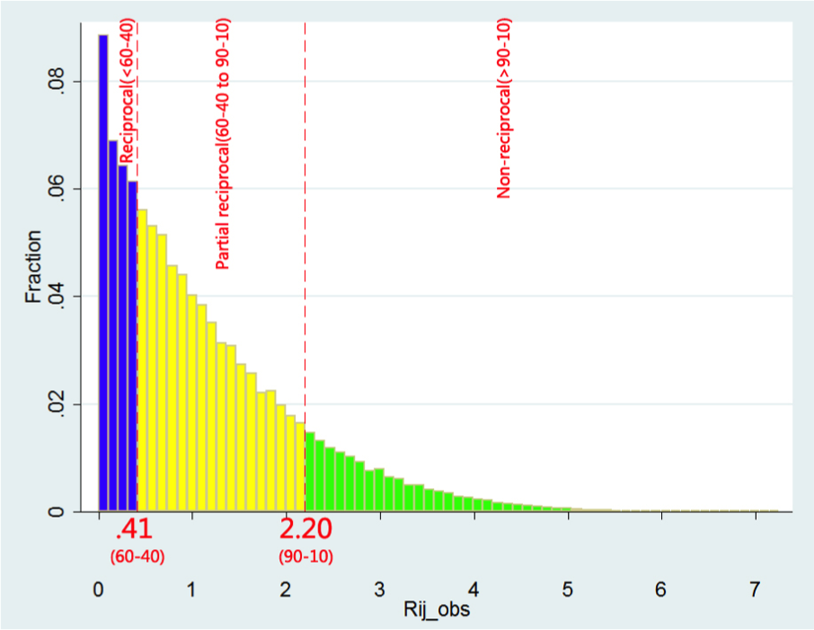
Reciprocity Distribution
27% of mutual dyads are reciprocal
58% partially reciprocal
14% non-reciprocal

Slide 29
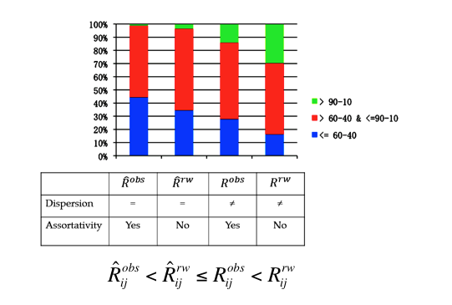
Results
Social Networks exhibit non-reciprocity because
  not fully degree assortative
  unequal dispersion

